Slide 1

Jhonson & Jhonson Automation Case Study

Slide 2

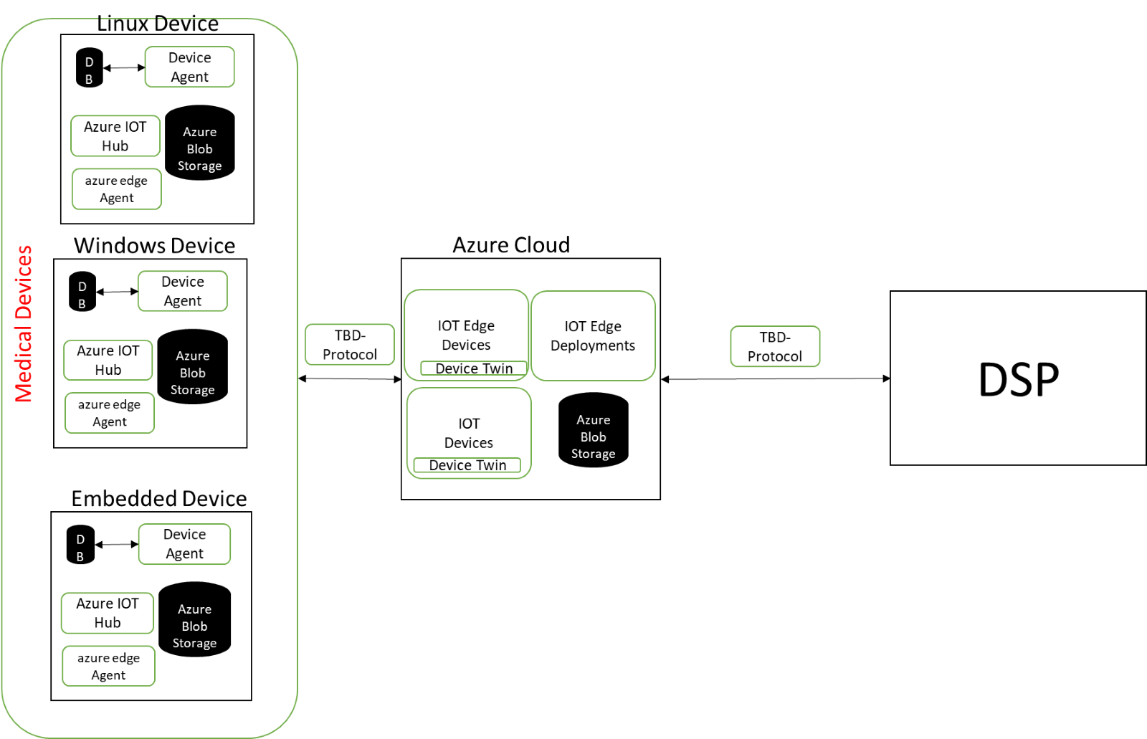
Case Study
Validation of MIOT Device & Platform
Happiest Minds’ Solution
The client is a leader in providing engineering solutions for MIOT segments: Robotic Arms, Medical Devices
Designed test scenarios for new features with comprehensive Test case design and realization of requirements for Device Agents across platforms.
Design and development of framework components using Pytest, BDD, REST API which is scalable & supports multiple medical devices/platforms
GXP standards evidence collection as a part of test automation process across various environments –QA, STAGING, PROD
Review and approvals of the Testcases in controlled environments by Quality Check team.
Test script enhancement & optimization done to reduce execution time / memory consumption
Designed Jenkins DevOps pipeline scripts to execute test scripts and publishing results for different products / regression suites
Types of Assets / Technologies
Python
Pytest/Robot
Groovy
Azure – IOT HUB, IOT EDGE AGENT,STORAGE CONTAINERS,REGISTRY, RESOURCE GROUPS
Git
Jenkins
POSTAMAN
REST API, SELENIUM
DOCKER & Containers
JIRA
Client Requirements
To perform end to end validation of Meditech solution [surgical platform] used for at various medical devices .
Test automation an integration into the CI/CD
To design & enhance existing framework with BDD approach, automate new features.
Maintenance of various releases activities for MIOT platform
Value Delivered
CLICK HERE FOR TEST ENVIRONMENT
Increase the test coverage for the existing testcases
Comprehensive evidence collection across environments for all Testcases and release maintenance
Consistently maintain test automation coverage of over 95% across the releases.

